Slide 1
Network Monitoring
Presented By:
Dipendra Singh Mal | Hardik Jain | Samaksh Gulati

Slide 2


Problem Statement
INTRO
In this project, a water utility company, and more specifically a network operator, is interested
in allocating pressure sensors on nodes in order to detect pipe bursts in its water distribution
Network.
Problem Parameters:
The network is composed of 1123 pipes and 811 nodes.
It provides 2.09 million gallons of water per day to its 5,010 customers.
Each node can receive at most one sensor.

Slide 3
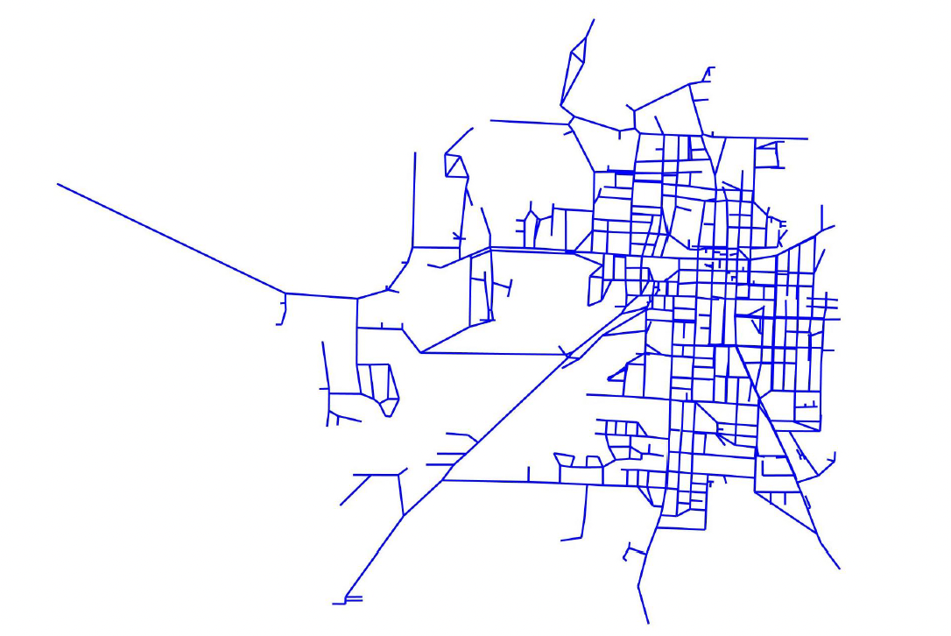
Input Variables and Layout
INTRO
We denote V the set of 811 nodes/sensor locations, and E the set of 1123 network pipes.
We are given a detection matrix, denoted F ∈ {0, 1}|E|×|V|, that represents the sensing capabilities of the pressure sensors.
F is a binary matrix of size |E| × |V| = 1123 × 811, and is such that fe,v = 1 if a sensor placed at location v ∈ V can detect a burst of pipe e ∈ E.
 | 0 | 1 | 2 | 3 | 4 | … | 806 | 807 | 808 | 809 | 810
0 | 1 | 0 | 0 | 0 | 0 | … | 0 | 0 | 0 | 0 | 0
1 | 0 | 1 | 0 | 0 | 0 | … | 0 | 0 | 0 | 0 | 0
… | … | … | … | … | … | … | … | … | … | … | …
1122 | 0 | 0 | 0 | 0 | 0 | … | 0 | 0 | 0 | 0 | 0
Snapshot of the Detection matrix

Slide 4
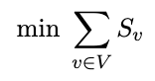
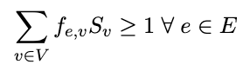
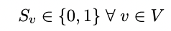
Part a/b - Minimum Number of Sensors (1/1)
Problem 1
After solving in Gurobi, these nodes will have a sensor*
The minimum number of sensors is 19
Determine the minimum number of sensors, and where to locate them, so that if any pipe
bursts, then at least one sensor will detect it.
Decision Variable: Let S_{v} be a binary variable to indicate 1 if a sensor is placed at node v and 0 if it is not.
Objective Function: Minimizing the total number of sensors on all nodes
Constraints:
At least one sensor should detect any pipe bursts
Sv is a binary decision variable (1: We placed a sensor on node v; 0: otherwise)
16 | 78 | 104 | 206 | 233 | 277 | 392
393 | 424 | 426 | 430 | 438 | 454 | 482
651 | 705 | 712 | 748 | 786
* There are multiple optimal solutions for this problem hence the nodes could differ with each run.

Slide 5
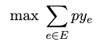
Part c/d - Maximize Pipe Bursts (1/1)
Problem 2
For this part, we have b pressure sensors and we need to determine their location such that it maximizes the expected number of pipe bursts that are detected..
Decision Variable:
Let S_{v} be a binary variable to indicate 1 if a sensor is placed at node v and 0 if it is not.
Let y_{e} be a binary variable to indicate 1 if pipe burst is detected for pipe e and 0 if it is not detected
Objective Function:
Maximizing the number of pipe bursts that are detected
The probability (p) of each pipe bursting independently is 0.1

Slide 6
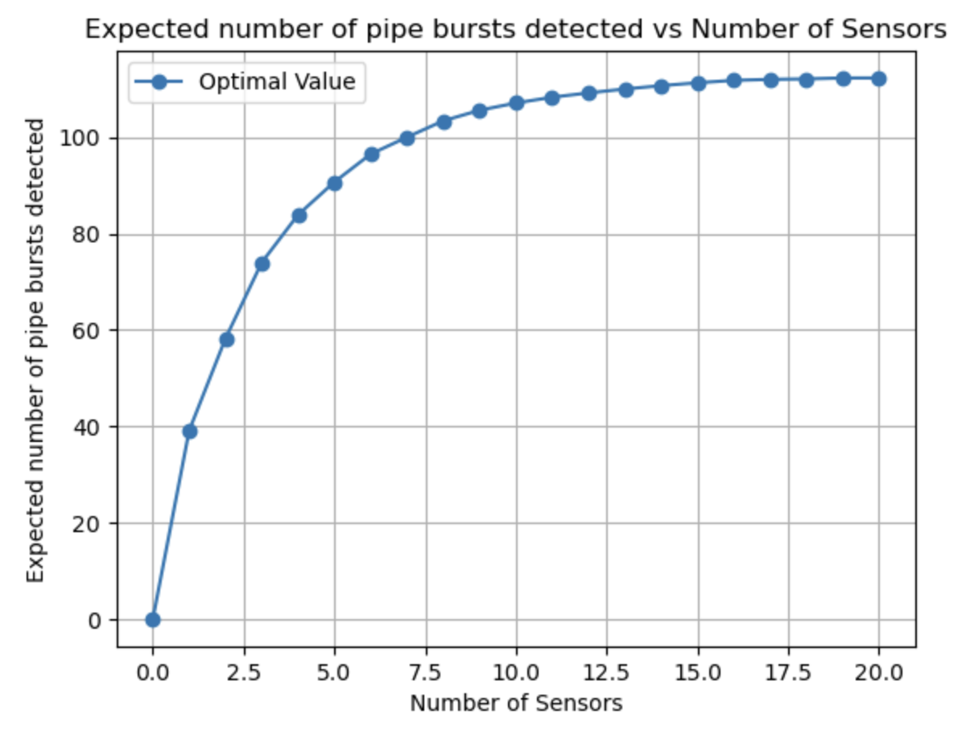
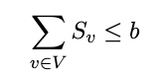
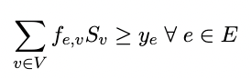
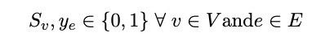
Part c/d - Maximize Pipe Bursts (2/2)
Problem 2
Constraints:
Availability of sensors to place:
Detection ye should be 0 if none of the sensors placed can detect the pipe burst at pipe e:
Sv and ye are binary decision variables:
(19, 112.3)
Objective Value*: 112.3

Slide 7
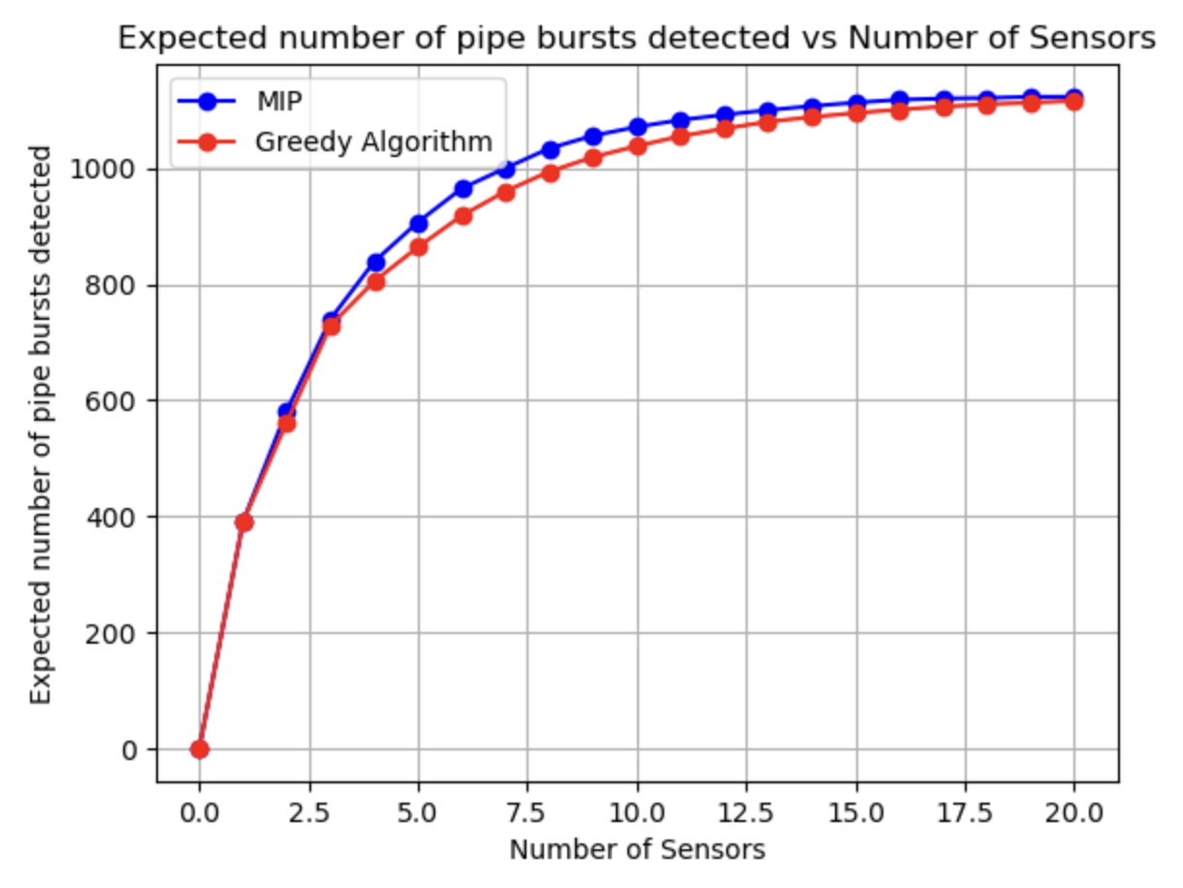
Part e - Greedy Approach
Problem 3
Algorithm:
Step 1 - Choose the node that the detects the maximum expected pipe bursts. Place sensor there
Step 2 - Now place the sensor at the node that detects the maximum expected number of pipe bursts that were not previously detected
Step 3 - Repeat until all sensors are positioned.
.
Compare MIP vs Greedy
 | MIP | Greedy Algorithm
Pipe bursts detected for 20 sensors placed | 1123 | 1116
Runtime | ~10 mins | ~5 seconds
No. of sensors to detect all pipe bursts | 19 | 25

Slide 8
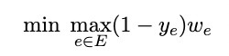
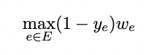
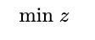
Part f/g - Minimize Highest Criticality (1/2)
Problem 4
For this part we have criticality level w_{e} for each pipe e (w_{e} ∈ [0, 1]) and we need to position b sensors as to minimize the highest criticality of a pipe that is not detected by any sensor.
Decision Variable:
Let S_{v} be a binary variable to indicate 1 if a sensor is placed at node v and 0 if it is not.
Let y_{e} be a binary variable to indicate 1 if pipe burst is detected for pipe e and 0 if it is not detected
Objective Function:
Minimize the highest criticality of a pipe that is not detected.
So, we take the maximum criticality from all the pipes that are not detected and minimize that:
Objective Function Formulation
Replacing with z

Slide 9
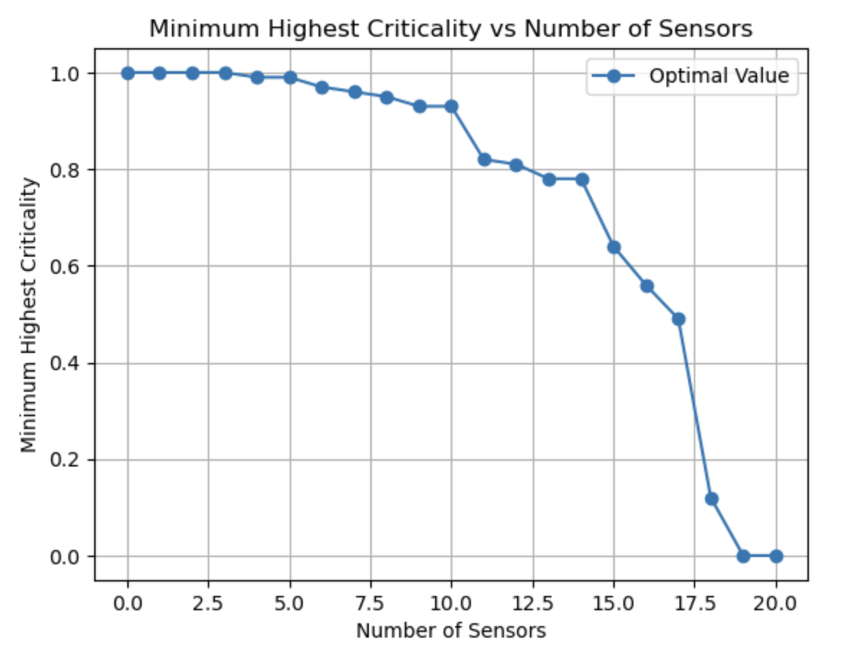
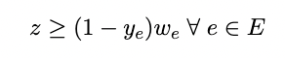
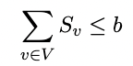
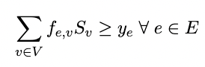
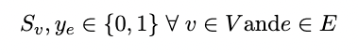
Part f/g - Minimize Highest Criticality (2/2)
Problem 4
Constraints:
Additional constraint because of max replacement
Availability of sensors to place:
Detection ye should be 0 if none of the sensors placed can detect the pipe burst at pipe
Sv and ye are binary decision variables
The highest criticality drops to 0 after 19 sensors since all pipe bursts are detected.
There is a steep decline in criticality score after 10 sensors

Slide 10

Thank You!

